Slide 1

SI Project Estimator Prototype User Guide for SI Practitioners

Slide 2

Contents
Goals and Objectives 2
Detailed Estimation Process 4
Overview 5
Set up Project 6
Define Estimation Scope 7
Fixed Resources 8
Select Phase Deliverables 9
Define System Objects 10
Define Testing Requirements 11
Summary 12
Detailed Process Overview 13
Overview 14
Prototype Overview 15
Menu 16
Project Details 17
Estimation Scope 19
Fixed Resources 21
Fixed Resources Limitation 24
Entering Details of Standard Deliverables 27
Entering User Defined Deliverable to a discipline 30
Entering Details of User Defined Deliverables 31
Initiate and Plan 32
Manage 33
Define 34
Design 35
Develop 36
Entering Details of Develop 38
Testing 42
Deploy 45
Close 46
Summary 47
Dashboard 50
Metrics 52
Appendix — Admin Tab 54

Slide 3
Goals and Objectives

Slide 4
Goals and Objectives of SI Project Estimator Prototype
Goals | Provide a streamlined approach for defining and estimating work efforts, calculate resource needs, and determine costs for implementation of systems integration projects. Collect metrics information. The information will then be fed into the upcoming System Integration (SI) PE&PS tool. An interim solution of the SI Project Estimation tool.
Objectives | Implement a parameter-driven approach to estimate work efforts Consistent SI estimates based on known efforts and recommends approaches to handle the unknowns Allows users to apply consistent systems integration aspects of custom development methodology while estimating work efforts Input our firm pricing model to estimate total project price Capture and document assumptions made during the efforts estimation

Slide 5
Detailed Estimation Process

Slide 6
Overview
Below is an overview of the steps to estimate a project using the SI Estimator Prototype:
Begin the estimation process by documenting project details in the Project Details tab.
Select SDLC phases that are in scope in the Scope Estimation tab.
Add fixed resources of the project in the Fixed Resources tab.
Select applicable deliverables for all phases that are in scope.
Select system objects that are in scope and define testing requirements.
Review detailed estimate in the Summary tab and take corrective actions, if necessary.
1
Set up Project
2
Define Estimation Scope
3
Fixed Resources
4
Select Phase Deliverables
5
Define System Objects
6
Define Testing Requirements
7
Summary

Slide 7
Set up Project
1
Set up Project
2
Define Estimation Scope
3
Fixed Resources
4
Select Phase Deliverables
5
Define System Objects
6
Define Testing Requirements
7
Summary
Objective: The purpose of this step is to establish a project in the SI Estimator prototype for which an estimate is to be determined.
Description | During project setup, the user is required to create a project based on information received from the pursuit team or the current project team. Examples of information needed to set up a project are client name, project details, project start and end date etc.
Prerequisite information | Client Name and Project Name. Start and End Date. Project Partner, Project Manager.
Key considerations | The duration of the project plays a critical role in estimation process and it must be collected prior to setting up a project. Rework will be required in the Fixed Resources tab if the Start and/or End Date of the project is modified.

Slide 8
Define Estimation Scope
1
Set up Project
2
Define Estimation Scope
3
Fixed Resources
4
Select Phase Deliverables
5
Define System Objects
6
Define Testing Requirements
7
Summary
Objective: To define the scope by selecting SDLC phases that apply to the project.
Description | During this step, the user defines the scope of the project by selecting the applicable SDLC phases. Note that the phases included in the prototype are consistent with the Playbook methodology.
Prerequisite information | Which SDLC phases are in scope for the project?
Key considerations | The user should think through the phase and discipline scope, as this may reduce the number of tasks that need to be analyzed. A task/deliverable cannot be included in scope if the associated phase is not selected as in-scope in the Estimation Scope tab.

Slide 9
Fixed Resources
1
Set up Project
2
Define Estimation Scope
3
Fixed Resources
4
Select Phase Deliverables
5
Define System Objects
6
Define Testing Requirements
7
Summary
Objective: To identify the fixed resources who are to be counted for estimating the project.
Description | Fixed resources in a project are those who contribute to the overall project or selective phases, independent of any specific SDLC Phase deliverables. Examples of fixed resources are Project Manager, Quality Manager, Project Controller etc.
Prerequisite information | A high-level understanding of the Deloitte allocation of fixed roles. A defined start and end date for the project and the fixed resources.
Key considerations | Think through specifying the fixed resources carefully so that their efforts are not counted in duplicates from deliverable efforts. The prototype is an excel-based tool and thus there are some limitations (please see Fixed Resources Limitations slide).

Slide 10
Select Phase Deliverables
1
Set up Project
2
Define Estimation Scope
3
Fixed Resources
4
Select Phase Deliverables
5
Define System Objects
6
Define Testing Requirements
7
Summary
Objective: To select deliverables for all SDLC phases that are to be included in estimating the project.
Description | The user selects all the project deliverables that are included in the effort. The user will also need to include the quantity and complexity of each deliverable or work product throughout the SDLC phases.
Prerequisite information | A high-level understanding of the project deliverables and work products. Determination of the technology components to be used in the project (e.g., Java, .NET, Mainframe).
Key considerations | Some of the deliverables have metrics (i.e., SI standard estimates) associated with them; however, the user can adjust the metrics as necessary. Please see the deliverables slides for more details.

Slide 11
Define System Objects
1
Set up Project
2
Define Estimation Scope
3
Fixed Resources
4
Select Phase Deliverables
5
Define System Objects
6
Define Testing Requirements
7
Summary
Objective: To select the technology objects required to develop and design the project.
Description | The user identifies all the technology objects in the design, and develop life cycle of the project. The user also enters the quantity and complexity of each object.
Prerequisite information | Determination of the technology components to be used in the project (e.g., Java, .NET, Mainframe).
Key considerations | Some of the technology objects have metrics associated with them; however, the user can adjust the metrics as necessary. Please see the deliverables slides for more details.

Slide 12
Define Testing Requirements
1
Set up Project
2
Define Estimation Scope
3
Fixed Resources
4
Select Phase Deliverables
5
Define System Objects
6
Define Testing Requirements
7
Summary
Objective: To select the testing phases and number of testing iterations needed for the project.
Description | The user determines all the testing phases and the number of testing iterations needed for the project. The user also determines deliverables associated with the testing phases.
Prerequisite information | Determination of the testing phases and iterations required for each phase. Determination of number of deliverables and complexities associated for each deliverable.
Key considerations | Some of the testing deliverables have metrics associated with them; however, the user can adjust the metrics as necessary. The user should determine which test phases are in scope (e.g., performance, integration, user acceptance etc.) The user is limited to 10 testing iterations per testing phase.

Slide 13
Summary
1
Set up Project
2
Define Estimation Scope
3
Fixed Resources
4
Select Phase Deliverables
5
Define System Objects
6
Define Testing Requirements
7
Summary
Objective: Review the deliverable cost and the fixed resources cost.
Description | After the user validates the estimated hours, he/she reviews the estimated costs. The user should review the rates of the fixed resources based upon the current pricing model. The user can also compare the cost generated by the prototype with the estimates based on the Gartner guideline.
Prerequisite information | All SDLC tabs and Fixed Resources tab have been filled out. Rates from the latest Deloitte Pricing Model are incorporated.
Key considerations | Review the fixed resources roles to ensure that fixed resources (other than the Quality and Project Managers) are not double counted. The rate of the fixed resources should be reviewed against the current pricing model or against the agreed rate between the project and client.

Slide 14
Detailed Process Overview

Slide 15
Detailed Process Overview
The key elements of the prototype estimation process are:
The scope of the project and assumptions.
The project timeline (Start and End Date)
The deliverables/work products which were based on the Playbook and EVD methodologies.
The objects/components (Java, .NET, and Mainframe) which are based on the quantity and the hours, either entered by the user or generated by the tool.
The fixed resources which are also an estimate of the total headcount of Project Manager, Quality Manager, Project Controller etc. the project will need until completion.
Contingency percentage which is added to each SDLC phase and included in the grand total.
The following slides provide more details on the use of prototype to estimate a SI project.

Slide 16
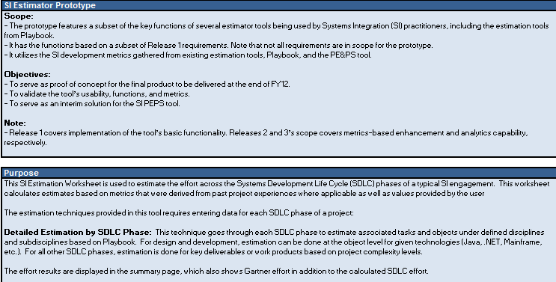
Prototype Overview
This is the first page of the prototype and it is mainly an informational page. The user is not required to enter any data.

Slide 17
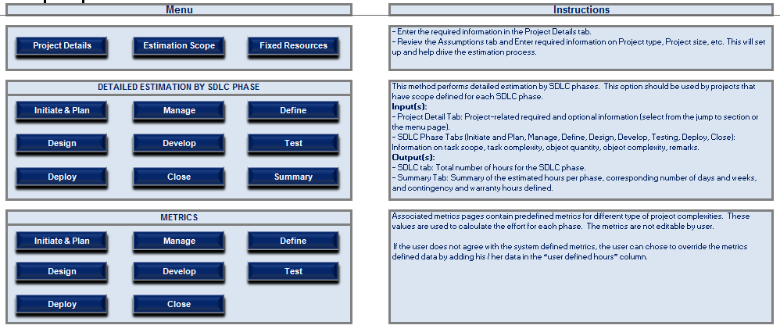
Menu
The Menu tab is the entry point to the estimation prototype.
The detailed estimation by SDLC phase is the only type of estimation method used by the prototype and is available through this tab.
The Metrics tabs are only available through this Menu tab.
The Metrics tab includes the deliverables and objects associated with Project’s SDLC phases.
The user can review, but not edit the metrics data through this tab.
The user can adjust these metric data/hours by selecting the phase in the “Detailed Estimation By SDLC Phase” table and entering non-standard hours in the “user defined” columns of each phase.

Slide 18
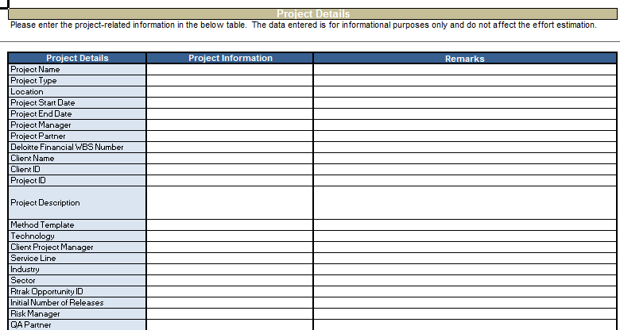
Project Details
This tab is available through the Menu tab. The user selects the Project Details tab to begin the estimation process. The user adds necessary project information in this tab. The Start and End Dates of the project are mandatory fields; all other fields are optional.
*Mandatory project
Start and End Dates
User enters project
information

Slide 19
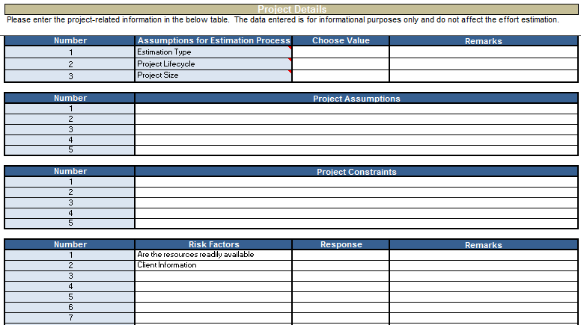
Project Details (cont.)
Select assumptions
if any from the
Drop-down Menu
Enter project
assumptions if any
Enter project
constraints if any
Select risk responses
if any

Slide 20
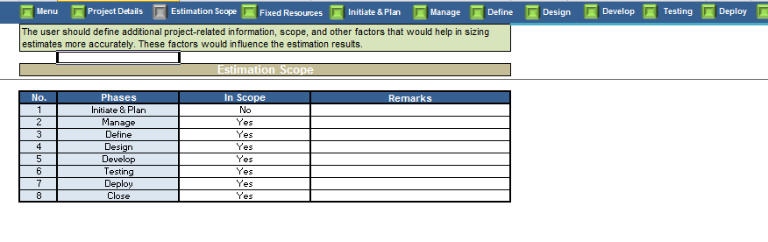
Estimation Scope
The Estimation Scope tab is used to include or exclude a phase(s) from the total estimation effort.
Information entered in this tab indicates whether a phase is in scope or out of scope.
If the user selects certain phases as “In Scope = Yes”, these phases will be included in the total effort. Based on the phases that are in scope, the user is able to add fixed resource assignments and deliverables/work products associated with these phases.
If the user selects certain phases as “In Scope = No”, these phases will not be included in the total effort and the user will be restricted from adding any further details (e.g. deliverables and work products) associated with these phases.
Select “Yes” for in scope if you
want to include estimates in the
total effort and “No” if you want
to exclude a phase from the estimation effort
Enter comments if any in
“Remarks”

Slide 21
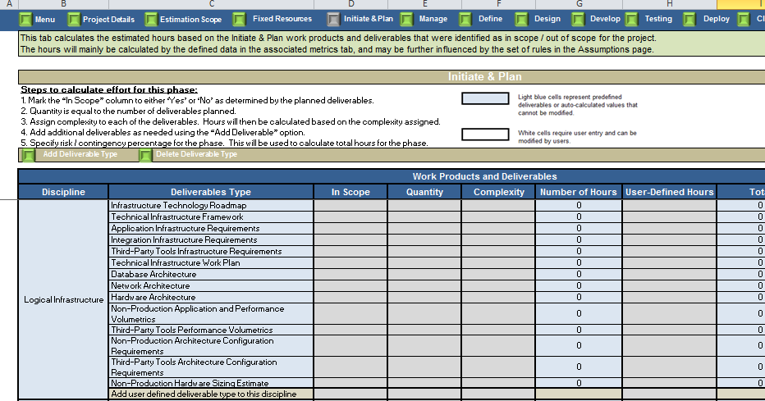
Estimation Scope (cont.)
Initiate and Plan tab is selected as In Scope = No in
“Estimation Scope.” The tab is grayed out completely.
User can neither enter any value nor delete or
modify anything.

Slide 22
Fixed Resources
The Project Manager and Quality Manager must be identified as Fixed Resources
To prevent double counting of hours, the deliverables associated with the Project Manager and Quality Manager have been excluded from the list of possible deliverables at other tabs and are shown on the Fixed Resources tab for reference only.
User may add up to two additional fixed resources. However, to prevent double counting of hours, ensure that none of the additional fixed resources have any direct contributions to any SDLC phase deliverables. Project controller is a typical example of another fixed resource.
The user must enter Start and End Date for each fixed role.
The user must select the phases applicable to each fixed resource. (e.g., the Quality Manager may be scheduled to join the project late and leave early, thereby contributing to Mange, Test, and Deploy, but may not work on Initiate and Plan and Deploy)”.
Estimator must enter billing rate and hours per week.
A link to Deloitte Pricing Model is included in this tab. The user can refer to the Deloitte Pricing Model for accurate billing rate.

Slide 23
Fixed Resources (cont.)
The user begins the estimation process for fixed resources by following the steps below:
Enter the Start and End Date for each phase.
The Start and End date for the overall project is populated from the Project Details tab, so the user does not need to enter it twice.
The user is allowed to enter one resource per “Fixed Resources Assignment” table.
The user enters the Role (Project Manager, Quality Manager, etc.), Start Date and End Date of each fixed resource.
For each fixed resource, the user enters the average hours per week the resource is scheduled to work.
The user enters the hourly rate of each resource.
A link to Deloitte Pricing System is available on this tab.
The user selects the phases that are applicable to each fixed resource.
The tool estimates the hours and cost by phase.
The tool also provides a grand total of hours and cost for each resource entered.

Slide 24
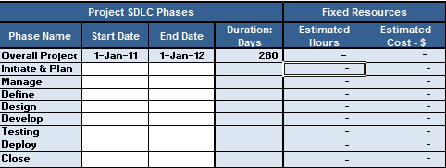
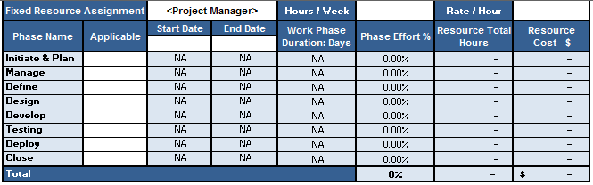
Fixed Resources (cont.)
The Start Date and End Date for the overall project is populated per the Project Details tab. The user needs
to enter the Start and End Date for each phase.
The user enters the fixed resource role (Project Manager, Quality Manager, etc.) and Start Date and End Date of his/her role. The user can also enter if a certain phase is applicable for the role or not. The effort hours are calculated only if the phase is applicable.

Slide 25
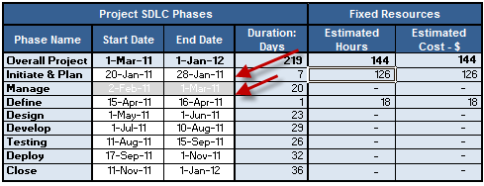
Fixed Resources Limitation
If the user changes a Start and/or End Date in the Project Details tab for the overall project, the tool does not apply the date validation of the new dates in the Fixed Resources tab. It is the estimator’s responsibility to revise the dates in the Fixed Resources tab.

Slide 26
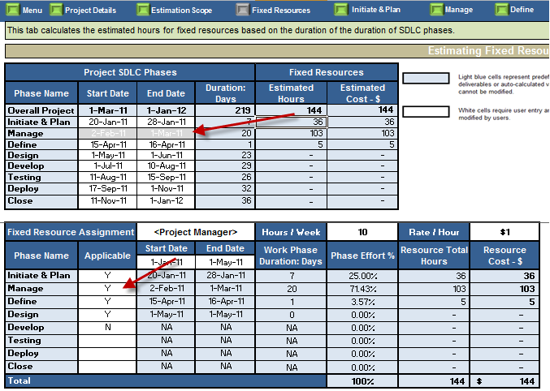
Fixed Resources Limitation (cont.)
If the user selects a SDLC phase in the Estimation Scope tab as out of scope, the phase is then grayed out (uneditable) on the Fixed Resources tab. However, the user must manually select the phase as Applicable = No in the “Fixed Resources Assignment” tab in order to display this change.

Slide 27
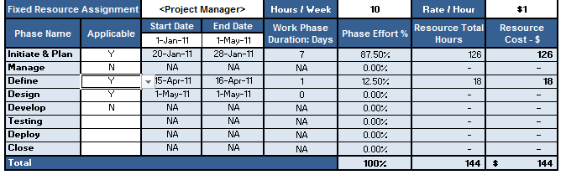
Fixed Resources Limitation (cont.)
Because the SDLC phases may be staggered, the estimation tool proportionally distributes the total hours of a fixed resource to all the phases assigned to him/her. It calculates the total hours by multiplying the number of hours per week with the duration derived from start and end date of the resource. The distribution of hours by phase works well when a fixed resource is assigned to one or more phases so that there is no idle time for the resource. However, if a fixed resource is assigned to selective phases only, it may introduce an idle time for the resource (depending on the start and end date of applicable phases). In that case, the allocation of total hours by phase may result in allocating excess hours to some phases to make up the loss (of hours) due to the resource’s idle time. The user may resolve this situation by splitting a role into multiple roles so that it does not introduce an idle time.

Slide 28
Entering Details of Standard Deliverables
Standard deliverables are consistent with the Playbook and EVD methodologies, and are deemed important for accurate estimation of the effort.
Standard deliverables are defined for each SDLC phase.
The user needs to complete the standard deliverables details, which include the following:
Mark the “In Scope” column to either “Yes” or “No” as determined by the planned deliverables.
Enter the quantity information, which is equal to the number of deliverables (or work products) planned per phase.
Assign complexity for the deliverables that are in scope. Valid values for the complexity level are Simple, Average, Complex, and Very Complex.
If the deliverables have predefined metrics, the “Number of Hours” column will be populated for deliverables that are in scope.
If the deliverables do not have metrics defined for it, the “Number of Hours” column will not be populated, and the user will need to input the hours in the “User -Defined Hours” column.
The user can also override the predefined metrics by typing in the hours in the “User-Defined Hours” column.
The “Total” column calculates the total of “quantity” multiplied by the hours as indicated in the “Number of Hours” or the “User-Defined Hours” column.

Slide 29
Entering Details of Standard Deliverables (cont.)
By selecting the “Add Deliverable” option, the user can add additional deliverables that are not listed in the tabs.
The risk/contingency percentage is defaulted to 10%, but the user can modify this to allow for varying calculations depending on project, specific deliverables, and/or phase.
The Grand Total row combines the subtotal information along with the pre-populated or user-entered risk/contingency percentage.

Slide 30
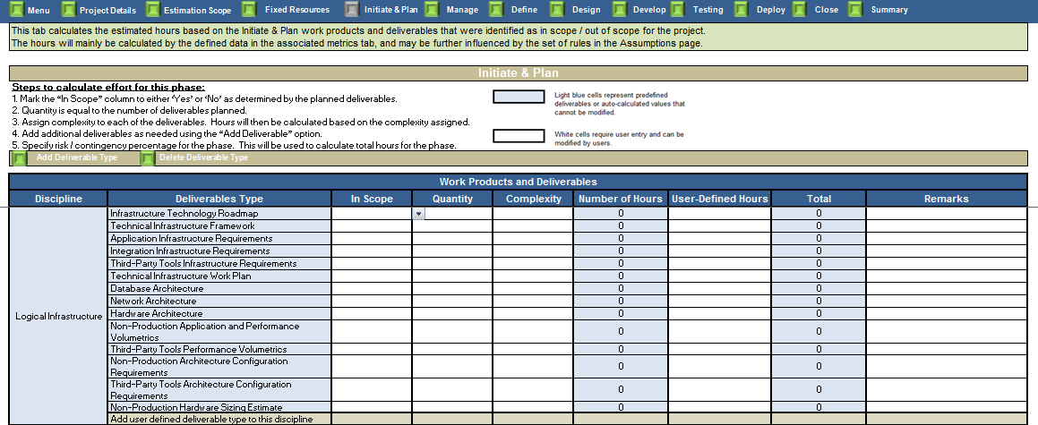
Entering Details of Standard Deliverables (cont.)
The user enters “Yes” or “No” for In Scope. If “No” is selected, user editable rows will be grayed out.
Enter quantity
Enter complexity
Enter custom hours

Slide 31
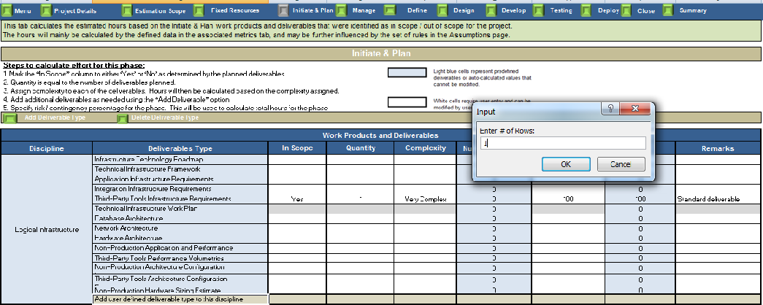
Add User Defined Deliverable to a Discipline
User selects the gray
row in the deliverable type
column
The user selects “Add
Deliverable Type”
The user enters the
number of additional
deliverables to add, then
selects OK

Slide 32
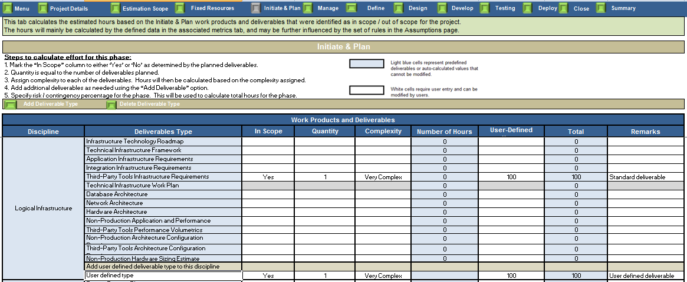
Entering Details of User Defined Deliverables
Deliverable with a default
name of “user defined
type” gets added
“User defined type” is
editable. The user
edits the name of the
deliverable appropriately
All other values, in scope,
quantity, complexity, user
defined hours and
remarks can be entered
similar to the standard
deliverables

Slide 33
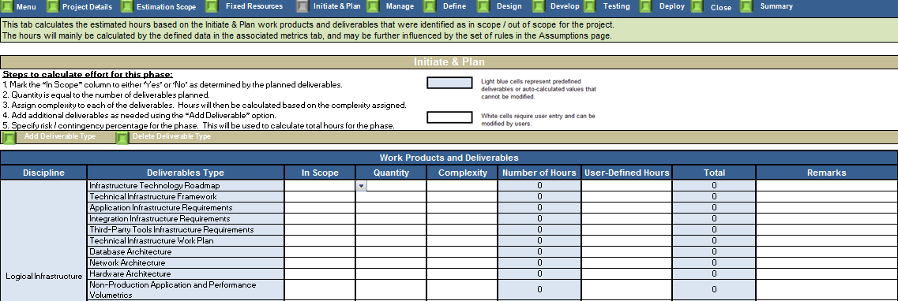
Initiate and Plan
Initiate includes the tasks for establishing the project’s charter, defining the project’s scope and business requirements, and planning the project’s “Initiate and Plan” phase. While Plan includes planning the project’s overall approach, resources, tools, budget, controls, and schedule to direct and support effective and efficient project execution, it includes adjusting and refining plans and procedures as the project progresses and evolves.
Please see the “Entering Details for Standard Deliverables” (slide# 27-29) for information on how to complete the effort associated with this tab.
The user enters “Yes” or “No” under In Scope column. If “No” is selected ,user editable rows will be grayed out.
Enter quantity
Enter complexity
Enter custom hours

Slide 34
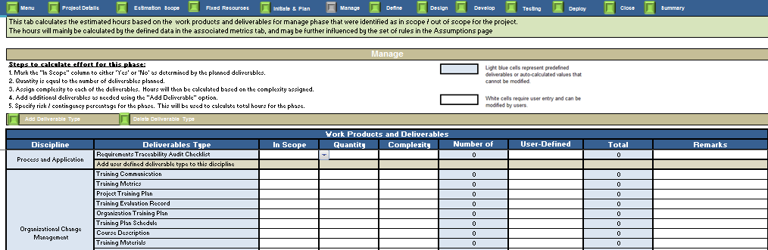
Manage
The Manage phase begins at project inception and runs in parallel with all other project phases through project closure.
Please see the “Entering Details for Standard Deliverables” (slide# 27-29) for information on how to complete the effort associated with this tab.
The Fixed Resources tab also addresses the Project manager role associated with this tab.
The user enters “Yes”
or “No” for In Scope. If “No” is selected ,user editable rows will be grayed out.
Enter quantity
Enter complexity
Enter custom Hours

Slide 35
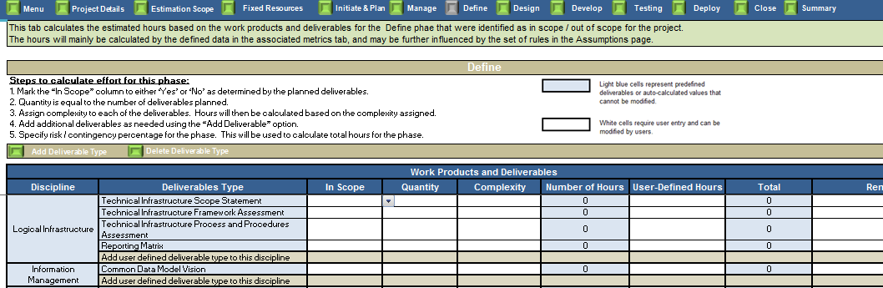
Define
The Define phase describes the requirements gathering and project planning processes.
Please see the “Entering Details for Standard Deliverables” (slide# 27-29) for information on how to complete the effort associated with this tab.
The user enters “Yes”
or “No” for In Scope. If “No” is selected, user editable rows will be grayed out.
Enter quantity
Enter complexity
Enter custom Hours

Slide 36
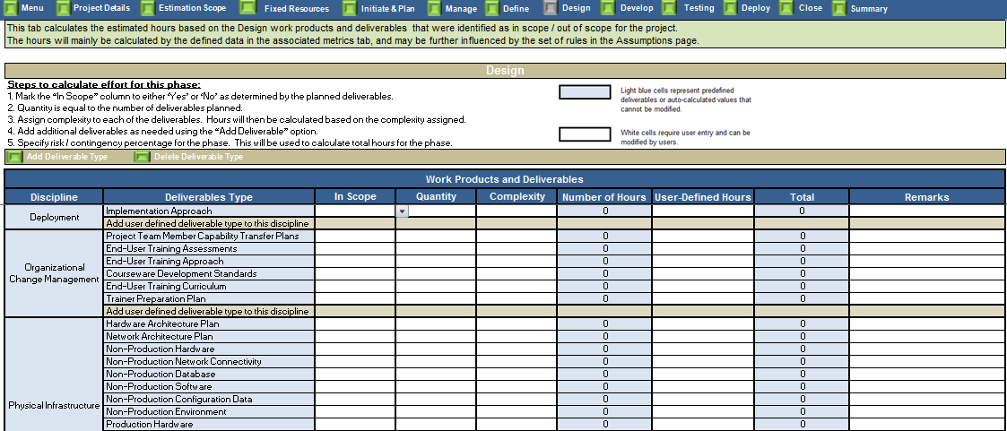
Design
The Design phase describes the “high level” and detailed design processes. The high-level design document provides a conceptual view of the application, while the detailed design document serves as the blueprint for development.
The effort calculation for this tab is identical with the previous tabs.
The user enters “Yes”
or “No” for In Scope. If “No” is selected user editable rows will be grayed out
Enter quantity
Enter complexity
Enter custom hours

Slide 37
Develop
The Develop tab is based on four distinct tables:
The deliverable table, which contains the standard deliverables. The user has to complete the standard deliverables details, which include the following:
Mark the “In Scope” column to either “Yes” or “No” as determined by the planned deliverables for the project.
Enter the quantity information, which is equal to the number of deliverables planned per phase.
Assign Complexity to each of the deliverables.
The user can also add additional deliverables that are not listed in the tabs by selecting the “Add Deliverable” option.
The three remaining tables contain technology specific (Java, .NET, and Mainframe) objects/components.

Slide 38
Develop (cont.)
Java, .NET, and Mainframe tables:
In these tables, the user is provided with the objects “End Products” associated with the technology.
Similar to the standard estimate table, the user will select whether an end product is in scope or not and input the quantity of each.
The user can also add additional deliverables that are not listed in the tabs by selecting the “Add Deliverable” option.
Metrics for deliverable types and products will automatically populate when the user enters all required information (if available).
The user can also input custom hours for design, develop, and unit Test respectively in the “User-Defined” columns.
Each table has an individual subtotal row.
These subtotal rows are factored into the grand total
When calculating the Grand Total, hours entered in the “User-Defined Hours” column take precedence over the default hours populated by the tool.

Slide 39
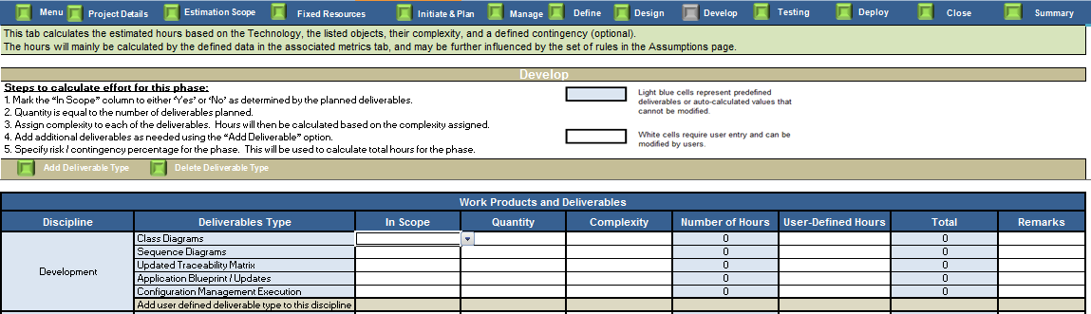
Entering Details of Develop
The user enters “Yes”
or “No” for In Scope. If “No” is selected user editable rows will be grayed out.
Enter quantity
Enter complexity
Enter custom Hours

Slide 40
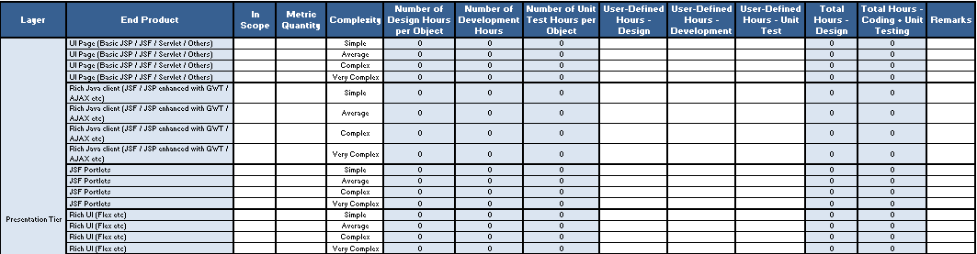
Entering Details of Develop (cont.)
In the Java, .NET, and Mainframe estimation tables, the user is provided with a list of “End Products” for each technology (Java, .NET, and Mainframe).
The user enters whether an end product is in scope for a particular complexity
Metric quantity for a given
complexity is inputted by the user

Slide 41
Entering Details of Develop (cont.)
Standard hours are listed
into design, development,
and unit test.
User-defined hours are split
into design, development,
and unit Test for each end
product and associated
complexity.

Slide 42
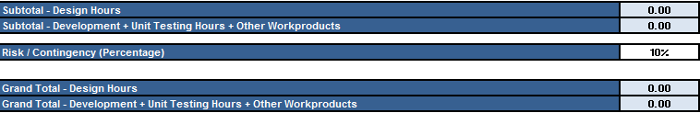
Entering Details of Develop (cont.)
The “subtotal” row is calculated based on the information from the correlating table(s).
The “risk/contingency” row displays 10%, but can be edited by the user, allowing for varying calculations depending on project circumstances.
The “grand total” row combines the subtotal information along with the percentage of user-entered risk/contingency.

Slide 43
Testing
The Testing tab includes system and integration testing, performance testing, regression testing, user acceptance testing, production environment testing, disaster recovery, and security testing.
The user can select any testing type to include in the estimate effort by selecting In Scope = Yes.
If a specific type of testing is not in scope (In Scope = No), the testing effort will not be included in the estimate effort.
The user can select multiple iterations for each test type, up to 10 iterations.
The user can select any deliverable to be included in each testing type.
Deliverables to be included in the testing effort should have the value of “In Scope = Yes”.
User should input the quantity, complexity and hours for each deliverable to be included in the testing effort.
The tool has a default contingency percentage of 10%. However, the user may change it as necessary.

Slide 44
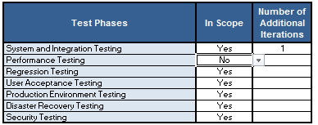
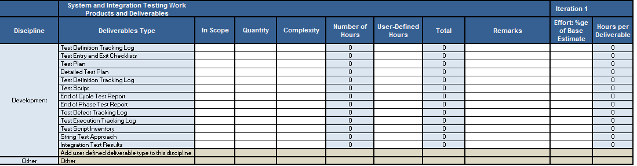
Testing (cont.)
List of test phases
User selects “Yes” if he/she wants to include test phase for estimations and “No” otherwise
Enter additional test iterations. It can be from 1
to 10.

Slide 45
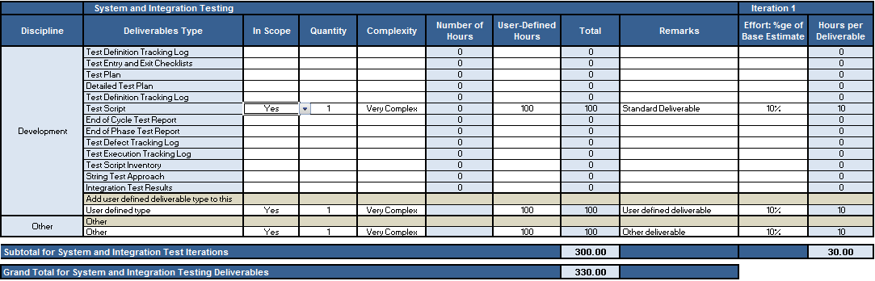
Testing (cont.)
Iteration hours
calculated by
applying percentage to total hours
Enter percentage of total hours
Subtotal for this iteration

Slide 46
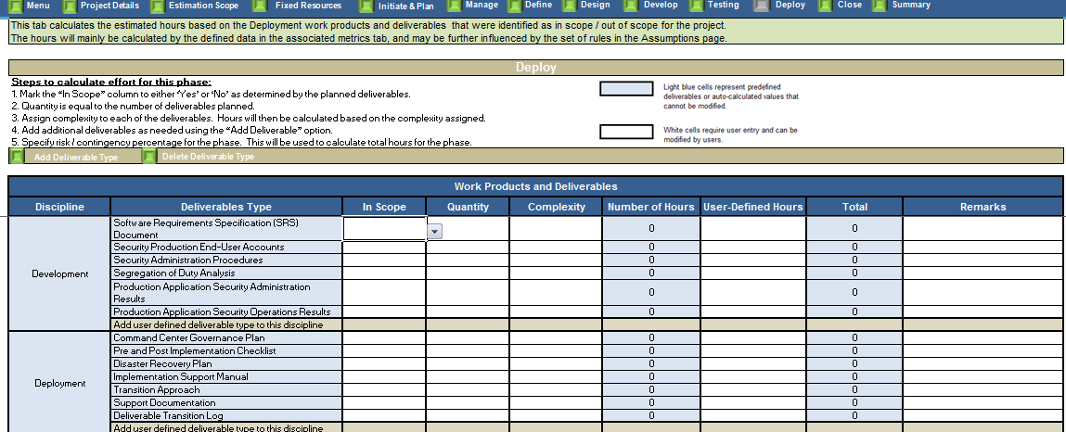
Deploy
The Deploy phase describes the process used for transitioning the built and tested software into a production environment.
Please see the “Entering Details for Standard Deliverables” (slide# 27-29) for information on how to complete the effort associated with this tab.
The user enters “Yes”
or “No” for In Scope. If “No” is selected ,user editable rows will be grayed out.
Enter quantity
Enter complexity
Enter custom hours

Slide 47
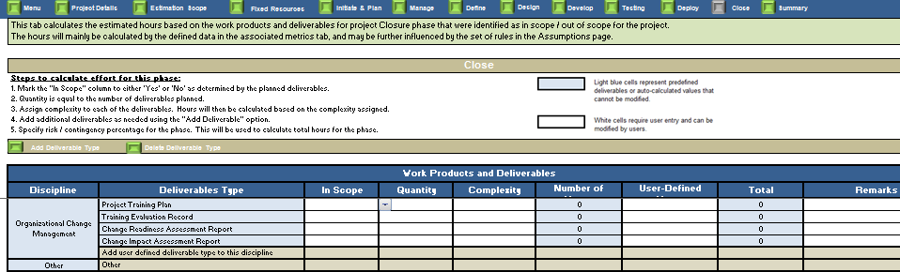
Close
Close involves performing the activities and checkpoints needed to confirm completion and close a project phase or the overall engagement.
Please see the “Entering details for Standard Deliverables” (slide# 27-29) for information on how to complete the effort associated with this tab
The user enters “Yes”
or “No” for In Scope. If “No”
is selected, user editable
rows will be grayed out
Enter quantity
Enter complexity
Enter custom hours

Slide 48
Summary
The following type of information user can get from the Summary tab:
Overall summary of the effort estimated for all phases
The percentage breakup of estimated effort based on an external analyst-prescribed estimate. Estimator can use this percentage to compare the efforts estimated by the Project Estimator
The Dashboard of contain the productivity metrics , effort distribution chart by complexity & deliverable count. The dashboard provide the key inputs for decision making and rationale in order to analyze and compare the estimated effort.
The Summary tab includes the grand total of the effort estimation using the data entered for each SDLC phase.
If a phase was selected to be out of scope on the "Assumptions" tab, any effort from that phase will be excluded in the total effort estimation.
Contingency percentage is included in the Grand Total of each phase. Therefore, it appears as part of the phase effort in the summary table.
The Fixed Resources tab is included in a different table, but the grand total effort includes hours from both the Fixed Resources tab and the SDLC estimation tabs.
The Gartner estimation is provided for the user to compare the effort estimation to an external analyst-prescribed estimate. This is provided for illustration purposes to compare the calculated effort estimation with Gartner-prescribed estimates based on percentage of development.

Slide 49
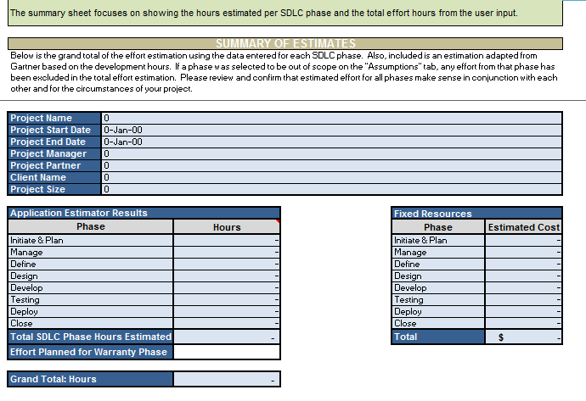
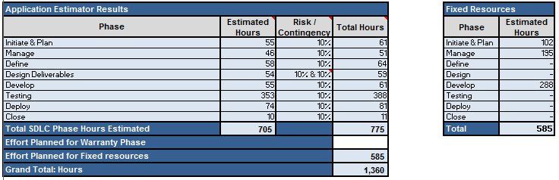
Summary (cont.)
Project details
Fixed resource
Summary
Phase and total summaries

Slide 50
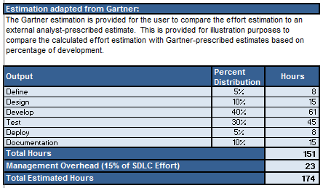
Summary (cont.)
Gartner Estimations Summary for
comparison purposes.

Slide 51
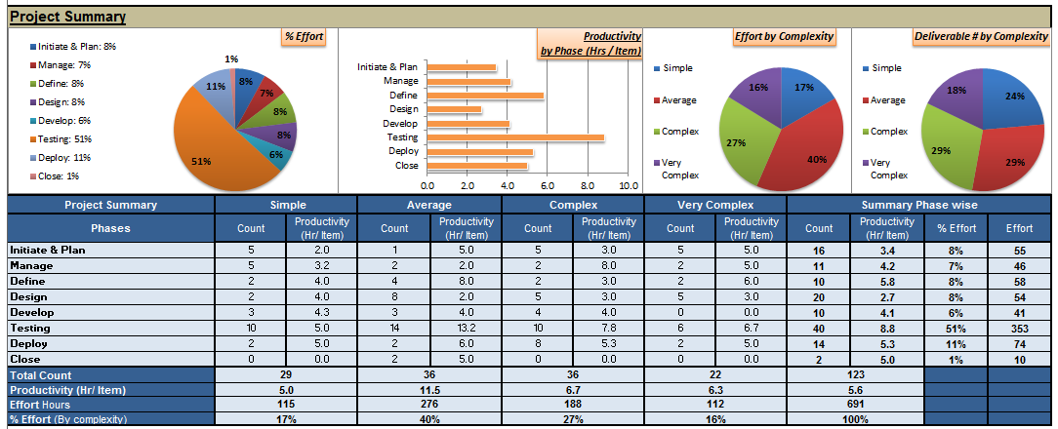
Dashboard Views: Added in the Summary tab
Quick view of key metrics in form of charts:
Overall Effort distribution across phases
Estimated productivity by phases
Effort distribution & Count of deliverable grouped by complexity
Below the Project Level dashboard view:
Deliverable count, their productivity categorized by SDLC phases and Complexity
Phase wise summary of Effort distribution, count of deliverable, productivity by SDLC phases
Project level Summary of number of deliverable, overall productivity, estimated effort

Slide 52
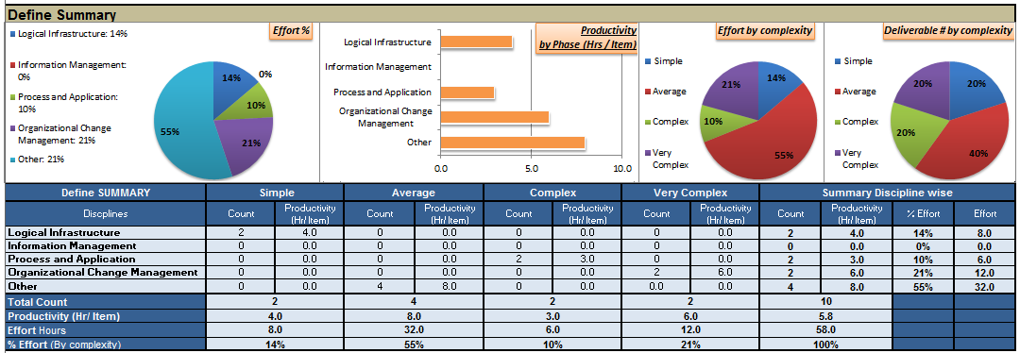
Dashboard Views: Added in the Summary tab (cont.)
Quick view of phase level key metrics in form of charts:
Overall Effort distribution across disciplines
Estimated productivity by disciplines
Effort distribution & Count of deliverable grouped by complexity
Below is a Typical view of the Phase Level dashboard:
Deliverable count, their productivity categorized by different disciplines in the phase and Complexity
Discipline wise summary of Effort distribution, count of deliverable, productivity estimated for each discpline
Phase level Summary of number of deliverable, overall productivity, estimated effort

Slide 53
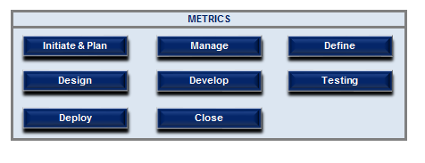
Metrics
The tool calculates the effort based on the metrics (SI standard estimate) associated with each deliverable/object. Some of these metrics are predefined and some are left blank for user input in appropriate tabs. The metrics value is based on the project complexity. The user can also chose to override the metrics defined data by entering hours in the “User-Defined Hours” column.
The user can select each phase in the below table to access the metrics associated with it; however, these pages are protected and the user can not edit the values in this tab.

Slide 54
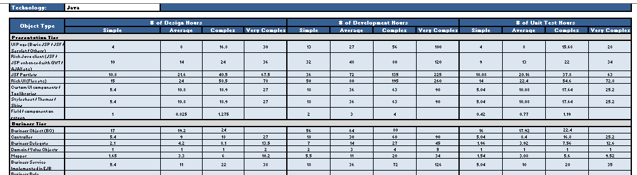
Metrics (cont.)
Below is the design, development, and unit test hours for some of the Java objects.

Slide 55
Admin Tab

Slide 56
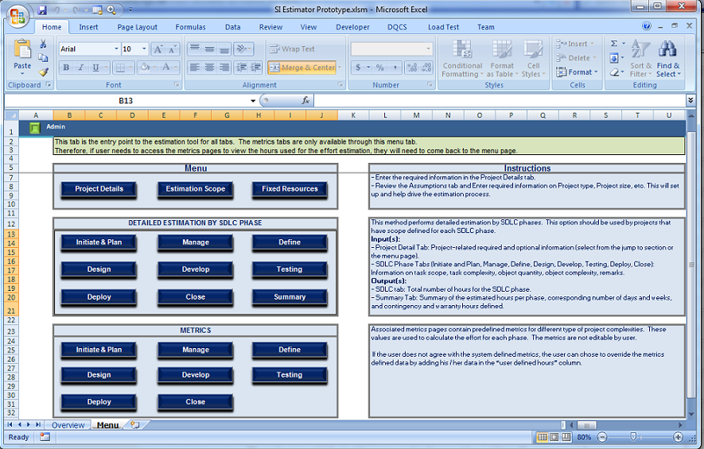
Admin Tab
From “Menu” tab, click on
“Admin” button
Delete “55”

Slide 57
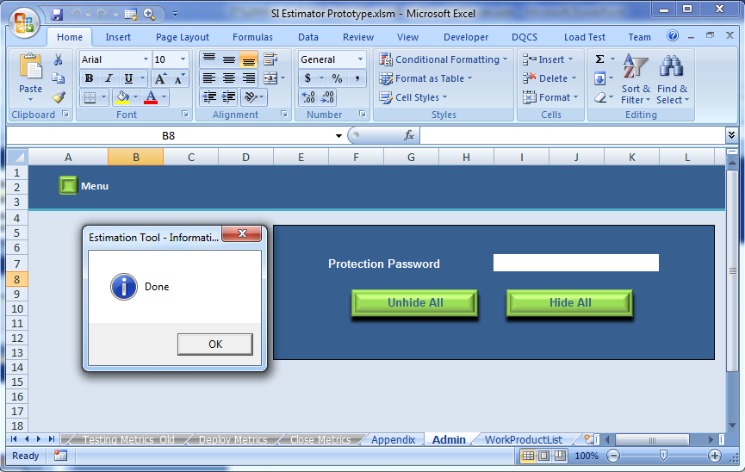
Admin Tab — Hide or Unhide all Tabs
Click on “Menu” button
to go to a specific tab.
Click Hide All or Unhide All to hide/unhide all tabs.

Slide 58
Copyright © 2011 Deloitte Development LLC. All rights reserved. Member of Deloitte Touche Tohmatsu Limited
Notes:
57

